Slide 1
Wireless Application Protocol (WAP)

Slide 2
WAP is an international standard establishing how mobile devices can access information on the Internet.
It is a widely used set of protocols used on wireless devices such as mobile phones and PDAs.

Slide 3
WAP stands for Wireless Application Protocol.
Wireless: Lacking or not requiring a wire or wires pertaining to radio transmission.
Application: A computer program or piece of computer software that is designed to do a specific task.
Protocol: A set of technical rules about how information should be transmitted and received using computers.
WAP is the set of rules governing the transmission and reception of data by computer applications on or via wireless devices like mobile phones. WAP allows wireless devices to view specifically designed pages from the Internet using only plain text and very simple black-and-white pictures.

Slide 4
WAP is a standardized technology for cross-platform, distributed computing very similar to the Internet's combination of Hypertext Markup Language (HTML) and Hypertext Transfer Protocol (HTTP), except that it is optimized for:
low-display capability
low-memory
low-bandwidth devices, such as personal digital assistants (PDAs), wireless phones, and pagers.
WAP is designed to scale across a broad range of wireless networks like GSM, IS-95, IS-136, and PDC.

Slide 5
Why is WAP Important?
Until the first WAP devices emerged, the Internet was a Internet and a mobile phone was a mobile phone. You could surf the Net, do serious research, or be entertained on the Internet using your computer, but this was limited to your computer.
Now with the appearance of WAP, the scene is that we have the massive information, communication, and data resources of the Internet becoming more easily available to anyone with a mobile phone or communications device.
WAP being open and secure, is well suited for many different applications including, but not limited to stock market information, weather forecasts, enterprise data, and games.
Despite the common misconception, developing WAP applications requires only a few modifications to existing web applications. The current set of web application development tools will easily support WAP development, and in the future more development tools will be announced.

Slide 6
WAP Microbrowser:
To browse a standard internet site you need a web browser. Similar way to browse a WAP enables website, you would need a micro browser. A Micro Browser is a small piece of software that makes minimal demands on hardware, memory and CPU. It can display information written in a restricted mark-up language called WML. Although, tiny in memory footprint it supports many features and is even scriptable.
Today, all the WAP enabled mobile phones or PDAs are equipped with these micro browsers so that you can take full advantage of WAP technology.
There are listed some of the key features offered by WAP:

Slide 7
Features
A programming model similar to the Internet's:
Though WAP is a new technology, but it reuse the concepts found on the Internet. This reuse enables a quick introduction of WAP-based services, since both service developers and manufacturers are familiar with these concepts today.
Wireless Markup Language (WML):
You must be using HTML language to develop your web-based application. Same way, WML is a markup language used for authoring WAP services, fulfilling the same purpose as HTML does on the Web. In contrast to HTML, WML is designed to fit small handheld devices.

Slide 8
Features
WMLScript:
Once again, you must be using Java Script or VB script to enhance the functionality of your web applications. Same way, WMLScript can be used to enhance the functionality of a service, just as Java script can be utilized in HTML. It makes it possible to add procedural logic and computational functions to WAPbased services.
Wireless Telephony Application Interface (WTAI):
The WTAI is an application framework for telephony services. WTAI user agents are able to make calls and edit the phone book by calling special WMLScript functions or by accessing special URLs. If one writes WML decks containing names of people and their phone numbers, you may add them to your phone book or call them right away just by clicking the appropriate hyperlink on the screen.

Slide 9
Features
Optimized protocol stack:
The protocols used in WAP are based on well-known Internet protocols, such as HTTP and Transmission Control Protocol (TCP), but they have been optimized to address the constraints of a wireless environment, such as low bandwidth and high latency.

Slide 10
The Internet Model:
The Internet model makes it possible for a client to reach services on a large number of origin servers, each addressed by a unique Uniform Resource Locator (URL).
The content stored on the servers is of various formats, but HTML is the predominant. HTML provides the content developer with a means to describe the appearance of a service in a flat document structure. If more advanced features like procedural logic are needed, then scripting languages such as JavaScript or VB Script may be utilised.
The figure below shows how a WWW client request a resource stored on a web server. On the Internet standard communication protocols, like HTTP and Transmission Control Protocol/Internet Protocol (TCP/IP) are used.

Slide 11
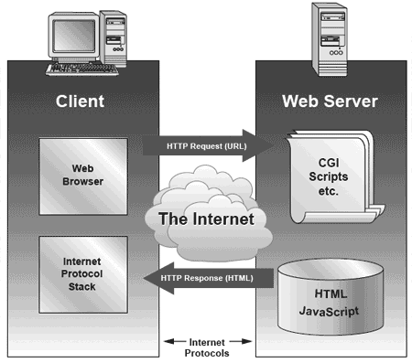
The Internet Model:

Slide 12
The Internet Model:
The content available at the web server may be static or dynamic. Static content is produced once and not changed or updated very often; for example, a company presentation. Dynamic content is needed when the information provided by the service changes more often; for example, timetables, news, stock quotes, and account information. Technologies such as Active Server Pages (ASP), Common Gateway Interface (CGI), and Servlets allow content to be generated dynamically.

Slide 13
The WAP Model:
The figure below shows the WAP programming model. Note, the similarities with the Internet model. Without the WAP Gateway/Proxy, the two models would have been practically identical.
WAP Gateway/Proxy is the entity that connects the wireless domain with the Internet. You should make a note that the request that is sent from the wireless client to the WAP Gateway/Proxy uses the Wireless Session Protocol (WSP). In its essence, WSP is a binary version of HTTP.
A markup language - the Wireless Markup Language (WML) has been adapted to develop optimized WAP applications. In order to save valuable bandwidth in the wireless network, WML can be encoded into a compact binary format. Encoding WML is one of the tasks performed by the WAP Gateway/Proxy.

Slide 14
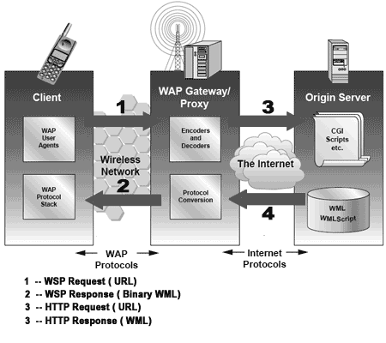
The WAP Model:

Slide 15
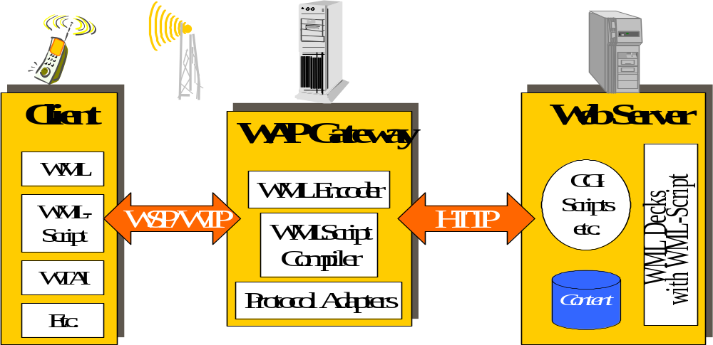
The WAP Architecture

Slide 16
More Acronyms to learn
WAE - Wireless Application Environment
WSP - Wireless Session Protocol
WTP - Wireless Transaction Protocol
WTLS - Wireless Transport Layer Security
WDP - Wireless Datagram Protocol

Slide 17
The WAP Model:
How WAP Model Works?
When it comes to actual use, WAP works like this:
The user selects an option on their mobile device that has a URL with Wireless Markup language (WML) content assigned to it.
The phone sends the URL request via the phone network to a WAP gateway using the binary encoded WAP protocol.
The gateway translates this WAP request into a conventional HTTP request for the specified URL and sends it on to the Internet.
The appropriate Web server picks up the HTTP request.
The server processes the request just as it would any other request. If the URL refers to a static WML file, the server delivers it. If a CGI script is requested, it is processed and the content returned as usual.

Slide 18
The WAP Model:
How WAP Model Works?
The Web server adds the HTTP header to the WML content and returns it to the gateway.
The WAP gateway compiles the WML into binary form.
The gateway then sends the WML response back to the phone.
The phone receives the WML via the WAP protocol.
The micro-browser processes the WML and displays the content on the screen.

Slide 19
The WAP Model:
WAP is designed in a layered fashion, so that it can be extensible, flexible, and scalable. As a result, the WAP protocol stack is divided into five layers:
Application Layer
Wireless Application Environment (WAE). This layer is of most interest to content developers because it contains among other things, device specifications, and the content development programming languages, WML, and WMLScript.
Session Layer
Wireless Session Protocol (WSP). Unlike HTTP, WSP has been designed by the WAP Forum to provide fast connection suspension and reconnection.
Transaction Layer
Wireless Transaction Protocol (WTP). The WTP runs on top of a datagram service, such as User Datagram Protocol (UDP) and is part of the standard suite of TCP/IP protocols used to provide a simplified protocol suitable for low bandwidth wireless stations.

Slide 20
The WAP Model:
Security Layer
Wireless Transport Layer Security (WTLS). WTLS incorporates security features that are based upon the established Transport Layer Security (TLS) protocol standard. It includes data integrity checks, privacy, service denial, and authentication services.
Transport Layer
Wireless Datagram Protocol (WDP). The WDP allows WAP to be bearer-independent by adapting the transport layer of the underlying bearer. The WDP presents a consistent data format to the higher layers of the WAP protocol stack, thereby offering the advantage of bearer independence to application developers.
Each of these layers provides a well-defined interface to the layer above it. This means that the internal workings of any layer are transparent or invisible to the layers above it. The layered architecture allows other applications and services to utilise the features provided by the WAP-stack as well. This makes it possible to use the WAP-stack for services and applications that currently are not specified by WAP.

Slide 21
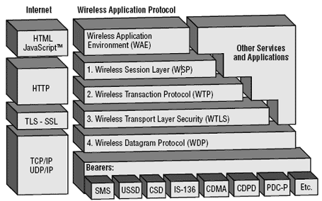
The WAP Model:
The WAP protocol architecture is shown below alongside a typical Internet Protocol stack.
the mobile network bearers in the lower part of the figure above are not part of the WAP protocol stack.

Slide 22
The WAP Model:
The uppermost layer in the WAP stack, the Wireless Application Environment (WAE) provides an environment that enables a wide range of applications to be used on wireless devices. In the chapter "WAP - the wireless service enabler" the WAP WAE programming model was introduced. The various components of WAE:
Addressing model
A syntax suitable for naming resources stored on servers. WAP use the same addressing model as the one used on the Internet that is Uniform Resource Locators (URL).
Wireless Markup Language (WML)
A lightweight markup language designed to meet the constraints of a wireless environment with low bandwidth and small handheld devices. The Wireless Markup Language is WAP's analogy to HTML used on the WWW. WML is based on the Extensible Markup Language (XML).

Slide 23
The WAP Model:
WMLScript
A lightweight scripting language. WMLScript is based on ECMAScript, the same scripting language that JavaScript is based on. It can be used for enhancing services written in WML in the way that it to some extent adds intelligence to the services; for example, procedural logic, loops, conditional expressions, and computational functions.
Wireless Telephony Application (WTA, WTAI)
A framework and programming interface for telephony services. The Wireless Telephony Application (WTA) environment provides a means to create telephony services using WAP.

Slide 24
Hardware and Software Requirement:
At minimum developing WAP applications requires a web server and a WAP simulator. Using simulator software while developing a WAP application is convenient as all the required software can be installed on the development PC.
Although, software simulators are good in their own right, no WAP application should go into production without testing it with actual hardware. The following list gives a quick overview of the necessary hardware and software to test and develop WAP applications:
A web server with connection to the Internet
A WML to develop WAP application
A WAP simulator to test WAP application
A WAP gateway
A WAP phone for final testing.
Microsoft IIS or Apache on Windows or Linux can be used as the web server and Nokia WAP Toolkit version 2.0 as the WinWAP simulator.

Slide 25
WAP Protocols
WSP (Wireless Session Protocol)
  Provides the application layer of WAP with a consistent interface for two session services.
    A connection-oriented service that operates above the transaction layer protocol WTP.
    A connectionless service that operates above a secure or non-secure datagram service (WDP).

Slide 26
WAP Protocols
WTP (Wireless Transaction Protocol)
  Provide efficient request/reply based transport mechanism suitable for devices with limited resources over networks with low to medium bandwidth.
    WTP Push mode allows server to “push” data to a client without request (e.g. notification of stock hitting target price)
    WTP/WDP uses less than half the packets that TCP/IP uses to transfer the same amount of data.

Slide 27
WAP Protocols
WTLS (Wireless Transport Layer Security)
  A security protocol based upon the industry-standard Transport Layer Security (TLS) protocol, formerly known as Secure Sockets Layer (SSL). WTLS is intended for use with the WAP transport protocols and has been optimized for use over narrow-band communication channels.

Slide 28
WAP Protocols
WDP (Wireless Datagram Protocol)
  The Transport layer protocol in the WAP architecture
  Provides a common interface to the Security, Session, and Application layers
  Allows these upper layers to function independently of the underlying wireless network. This is the key to global interoperability

Slide 29
WAP Developers
An incomplete list of corporations currently developing WAP products and/or services:
AT&T
Bell Atlantic Mobile
GTE
Sprint PCS
US West
Nextel
France Telecom
Telenor (Norway)
Bell Mobility (Canada)
Japan Telecom
Nokia
Ericsson
Motorola
Qualcomm
Samsung
Palm Computing (3Com)
IBM
Phone.com (Unwired Planet)

Slide 30
WML
Wireless Markup Language
Tag-based browsing language:
  Screen management (text, images)
  Data input (text, selection lists, etc.)
  Hyperlinks & navigation support
XML-based language
Inherits technology from HTML

Slide 31
WML
Wireless Markup Language
Card metaphor
  User interactions are split into cards
  Navigation occurs between cards
Explicit inter-card navigation model
  Hyperlinks
  UI Event handling
  History
State management and variables
  Reduce network traffic
  Results in better caching

Slide 32
Bluetooth
The Bluetooth wireless technology allows users to make effortless, wireless and instant connections between various communication devices, such as mobile phones, Personal Digital Assistants (PDA’s), desktop and notebook computers.
It currently provides a 2 Mbps data rate and a range of 500 ft indoors.

Slide 33
Bluetooth
  The Bluetooth radio is built into a small microchip and operates in a globally available frequency band ensuring communication compatibility worldwide.
  Software controls and identity coding built into each microchip ensure that only those units preset by their owners can communicate.
  The Bluetooth wireless technology supports both point-to-point and point-to-multipoint connections.

Slide 34
WAP - WML Syntax
The topmost layer in the WAP architecture is made up of WAE (Wireless Application Environment), which consists of WML and WML scripting language.
WML scripting language is used to design applications that are sent over wireless devices such as mobile phones. This language takes care of the small screen and the low bandwidth of transmission. WML is an application of XML, which is defined in a document-type definition.
WML pages are called decks. They are constructed as a set of cards, related to each other with links. When a WML page is accessed from a mobile phone, all the cards in the page are downloaded from the WAP server to mobile phone showing the content.
WML commands and syntaxes are used to show content and to navigate between the cards. Developers can use these commands to declare variables, format text, and show images on the mobile phone.

Slide 35
WAP - scope of standardization
Browser
  “micro browser”, similar to existing, well-known browsers in the Internet
Script language
  similar to Java script, adapted to the mobile environment
WTA/WTAI
  Wireless Telephony Application (Interface): access to all telephone functions
Content formats
  e.g., business cards (vCard), calendar events (vCalender)
Protocol layers
  transport layer, security layer, session layer etc.
Working Groups
  WAP Architecture Working Group, WAP Wireless Protocol Working Group, WAP Wireless Security Working Group, WAP Wireless Application Working Group

Slide 36
WAP - reference model and protocols
Internet
A-SAP
WAP
HTML, Java
Application Layer (WAE)
additional services
and applications
S-SAP
HTTP
Session Layer (WSP)
TR-SAP
Transaction Layer (WTP)
SEC-SAP
SSL/TLS
Security Layer (WTLS)
T-SAP
TCP/IP,
UDP/IP,
media
Transport Layer (WDP)
WCMP
Bearers (GSM, CDPD, ...)
WAE comprises WML (Wireless Markup Language), WML Script, WTAI etc.

Slide 37
WAP - network elements
fixed network
wireless network
Internet
WML
WAP
proxy
Binary WML
HTML
filter
HTML
WML
HTML
filter/
WAP
proxy
Binary WML
web
server
HTML
WTA
server
Binary WML
PSTN
Binary WML: binary file format for clients

Slide 38
WDP - Wireless Datagram Protocol
Protocol of the transport layer within the WAP architecture
  uses directly transport mechanisms of different network technologies
  offers a common interface for higher layer protocols
  allows for transparent communication using different transport technologies
  if IP is used, then WDP more or less translates to UDP
Goals of WDP
  create a worldwide interoperable transport system with the help of WDP adapted to the different underlying technologies
  transmission services such as SMS in GSM might change, new services can replace the old ones

Slide 39
WTLS - Wireless Transport Layer Security
Goals
  data integrity
    prevention of changes in data
  privacy
    prevention of tapping
  authentication
    creation of authenticated relations between a mobile device and a server
  protection against denial-of-service attacks
    protection against repetition of data and unverified data
WTLS
  is based on the TLS (Transport Layer Security) protocol (former SSL, Secure Sockets Layer)
  optimized for low-bandwidth communication channels

Slide 40
WTP - Wireless Transaction Protocol
Goals
  different transaction services, offloads applications
    application can select reliability, efficiency
  support of different communication scenarios
    class 0: unreliable message transfer
    class 1: reliable message transfer without result message
    class 2: reliable message transfer with exactly one reliable result message
  supports peer-to-peer, client/server and multicast applications
  low memory requirements, suited to simple devices (< 10kbyte )
  efficient for wireless transmission
    segmentation/reassembly
    selective retransmission
    header compression
    optimized connection setup (setup with data transfer)

Slide 41
WSP - Wireless Session Protocol
Goals
  HTTP 1.1 functionality
    Request/reply, content type negotiation, ...
  support of client/server, transactions, push technology
  key management, authentication, Internet security services
  session management (interruption, resume,...)
Services
  session management (establish, release, suspend, resume)
  capability negotiation
  content encoding
WSP/B (Browsing)
  HTTP/1.1 functionality - but binary encoded
  exchange of session headers
  push and pull data transfer
  asynchronous requests

Slide 42
WAE - Wireless Application Environment
Goals
  network independent application environment for low-bandwidth, wireless devices
  integrated Internet/WWW programming model with high interoperability
Requirements
  device and network independent, international support
  manufacturers can determine look-and-feel, user interface
  considerations of slow links, limited memory, low computing power, small display, simple user interface (compared to desktop computers)
Components
  architecture: application model, browser, gateway, server
  WML: XML-Syntax, based on card stacks, variables, ...
  WMLScript: procedural, loops, conditions, ... (similar to JavaScript)
  WTA: telephone services, such as call control, text messages, phone book, ... (accessible from WML/WMLScript)
  content formats: vCard, vCalendar, Wireless Bitmap, WML, ...

Slide 43
WAE logical model
Origin Servers
Gateway
Client
WTA
user agent
web
server
response
with
content
encoded
response
with
content
encoders
&
decoders
WML
user agent
other content
server
push
content
encoded
push
content
other
WAE
user agents
request
encoded
request

Slide 44
Wireless Markup Language (WML)
WML follows deck and card metaphor
  WML document consists of many cards, cards are grouped to decks
  a deck is similar to an HTML page, unit of content transmission
  WML describes only intent of interaction in an abstract manner
  presentation depends on device capabilities
Features
  text and images
  user interaction
  navigation
  context management

Slide 45
Examples for WAP protocol stacks
WAP standardization
WAE user agent
outside WAP
WAE
WSP
transaction based
application
WTP
WTP
datagram based
application
WTLS
WTLS
WTLS
UDP
WDP
UDP
WDP
UDP
WDP
IP
(GPRS, ...)
non IP
(SMS, ...)
IP
(GPRS, ...)
non IP
(SMS, ...)
IP
(GPRS, ...)
non IP
(SMS, ...)
1.
2.
3.
typical WAP application with complete protocol stack
pure data application with/without additional security

